Slide 1
Project Management:
Process, Technology, and Practice
Ganesh Vaidyanathan
Chapter 4
Project Initiation

Slide 2
Learning objectives
Select projects and set priorities
Select a project manager and project team
Write a project charter
Gather requirements for a project
Prepare and write a project scope

Slide 3
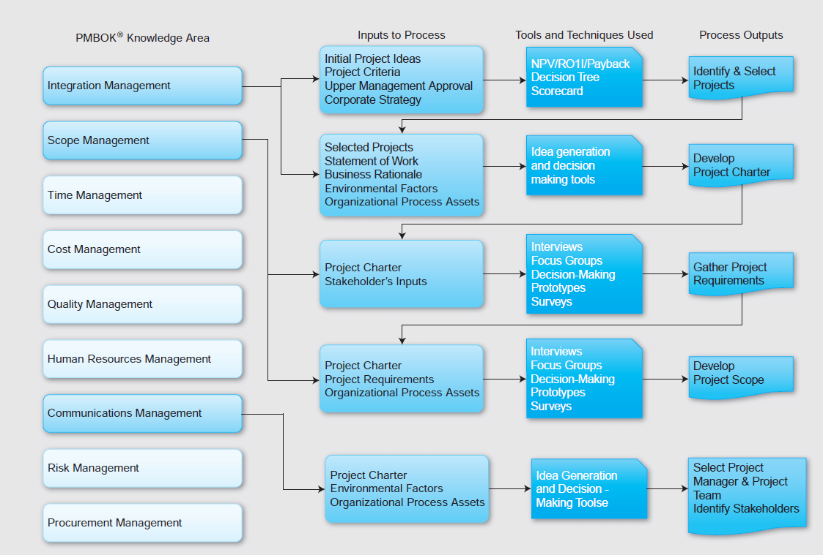

Slide 4
Project Selection
Form upper management team
Identify, organize, and set criteria for all projects including financial and qualitative factors
Gather data on all projects
Estimate time and resources required
Analyze and decide on projects
Implement initial project plans

Slide 5
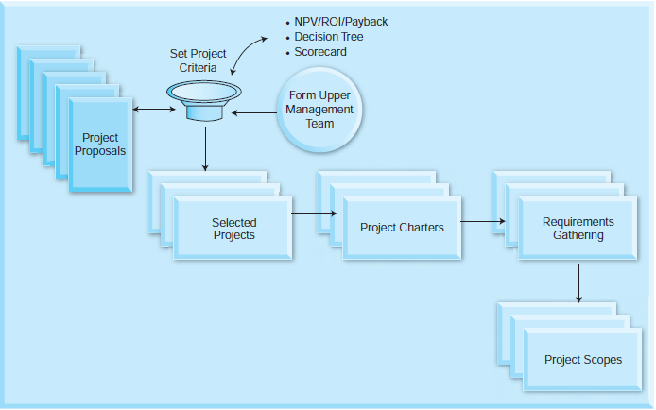
Project Selection Process

Slide 6
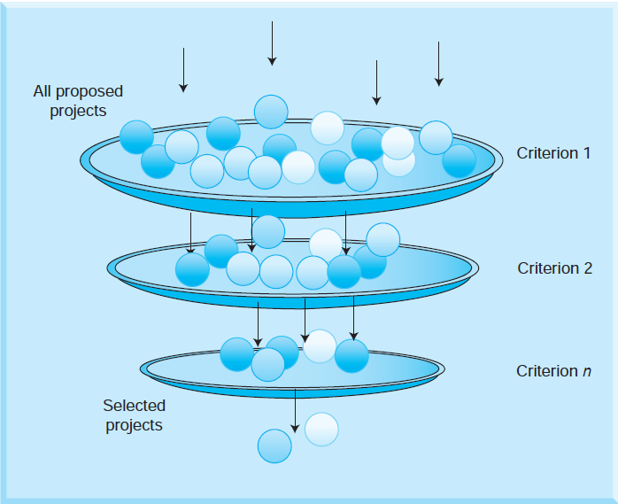
Screening of Projects

Slide 7
Project Selection
Projects can be categorized as one of the following:
Compliance: Projects that are essential to meet new requirements imposed by internal and external entities
Internal entities may be executive management
External entities may be government regulations and requirements
“Must do” projects; if not implemented, may face penalties
Emergency: Projects that are needed to meet emergency conditions; may be “must-do” projects; if not implemented, organizations may not be fully operational to fulfill their core competencies

Slide 8
Project Selection
Mission Critical: Critical to the mission of a company
If not completed, would cause immediate, unacceptably negative impact to business
Operational: Projects that are needed to support current operations
Increase process efficiency
Reduce product cost
Improve performance and other metrics
Strategic: Projects that are essential to support long-range mission (increase revenue, increase market-share)

Slide 9
Project Strategy
Provides the intellectual frameworks, conceptual models, and governing ideas that allow managers of an organization to identify opportunities for bringing value to customers and for delivering that value for a profit
The way an organization defines its business for a better future
Organizations need to take advantage of the opportunities that projects represent.
Dynamically guides project actions and decision making as the project environment changes
Projects need to be chosen and fielded to help achieve strategic intent. It is important to note that projects must deliver a product, service, or process that will provide the competitive advantage or value envisioned by the strategies of organizations.

Slide 10
Project Strategy
In many projects, value cannot be attained without the use of new technologies.
Technology poses many risks and managers need to evaluate such perceived risks well before the beginning of projects.
The skill requirements of using such technologies need to be analyzed before project initiation as well.
All risks need to be evaluated for future projects in order to select the projects. Projects provide future opportunities and opportunities mean more uncertainty and greater risk.

Slide 11
Project Strategy and Value
Project strategic value is defined as the impact a project will have on external entities like customers and suppliers.
Competitive differentiation may depend upon:
Economies of scale
Product differentiation
Capital Requirements
Access to distribution channels
Cost disadvantages independent of scale
Government policies
Perceived competitive reactions in the market, and
Price of organization’s products and services.

Slide 12
Project Strategy and Value
Value of a project can be determined by cash benefits (both magnitude and its timing).
Magnitude and timing of cash benefits when compared to investments made on the projects have to be evaluated in project selection as well.
If a project is not expected to bring some benefit to the organization, then there is no point in implementing this project.

Slide 13
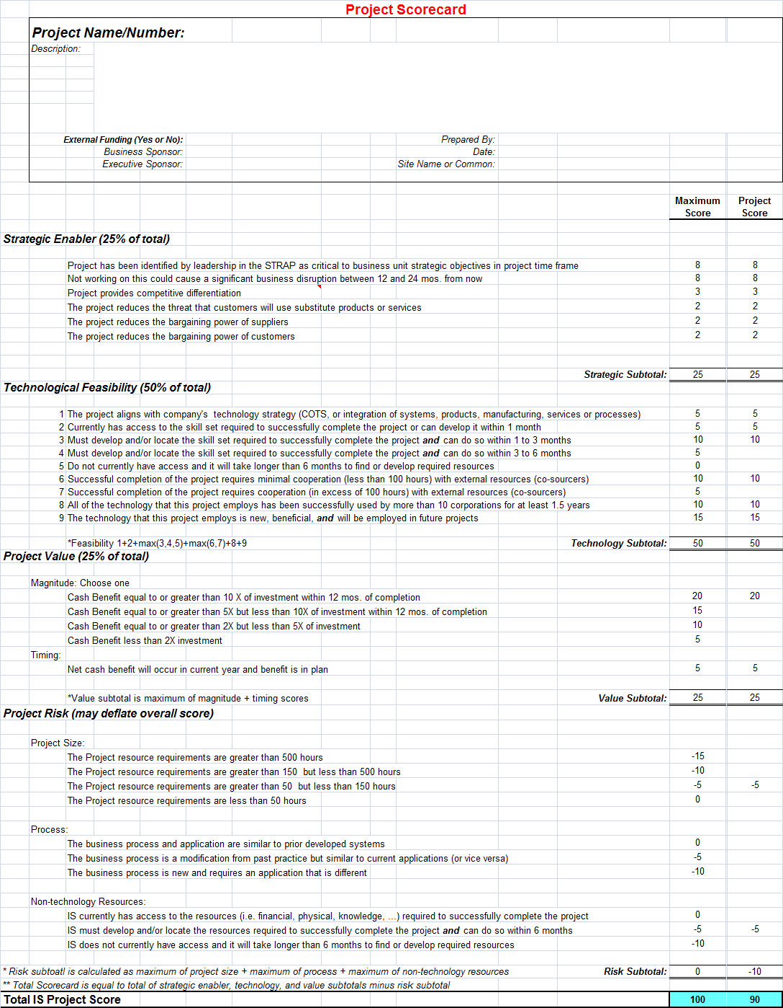
Scorecard analysis (Qualitative)

Slide 14
Project Charter
A project charter is a document that formally recognizes a project, includes a problem statement, project objectives, benefits, process owners, and a project sponsor or a champion.
Project purpose or justification
Project objectives
Project success criteria
Project description
Project risks at a high level
Key milestones
Budget information

Slide 15
Project Charter
High level requirements of the project
Project approval requirements
Roles and responsibilities of the project manager and the project team
Level of authority of the project manager
Sponsor and authorizing persons of the project charter

Slide 16
PM selection
The challenges for an organization to recruit effective project managers include:
Ensuring that only qualified individuals are assigned to project management positions.
Ensuring that an internal policy is designed, instituted, and followed to foster professional growth and development of such project management positions.
Providing proper authority and accountability to project managers.
Providing necessary management support.
Ensuring that necessary resources are available for projects.

Slide 17
PM characteristics
Personal
Is honest and has integrity
Assertive and confident
Friendly and optimistic
Enthusiastic and motivated
Has a high energy level
Has a sense of humor
Professional
Able to work under uncertainty
Adaptable to situations
Well organized
Understands business issues

Slide 18
PM characteristics
Relational
Team player
Good written and oral communication skills
Able to listen actively
Able to present outcomes effectively
Able to work effectively in teams
Able to be a facilitator
Respected by others
Patient and shows perseverance
Able to motivate and bring out the best in others

Slide 19
PM Skills
Satisfying end user and customer requirements
Performing flawlessly
Satisfying a myriad of technical performance criteria
Being user friendly and cost effective
Designing and implementing with quality
Providing great value to an organization, its suppliers, and its customers
Making sure that products are easily maintainable and services are easily accessible

Slide 20
PM qualifications
Ability to plan project activities effectively
Ability to schedule meetings, take copious notes, distribute meeting notes, and communicate effectively in meetings
Good people skills
Knows how to solve disputes
Knows how to deal with people from varied cultural and technology backgrounds
Knows how to motivate team members to achieve milestones
Ability to manage scope and ensure that the project scope does not grow beyond negotiated requirements
Great attitude and enthusiasm

Slide 21
PM qualifications
Ability to manage change and exceptions in projects effectively
Ability to build teams
Ability to maintain stakeholder satisfaction, especially customer satisfaction
Ability to monitor and control all the six factors of success
Very familiar with financial and budgeting processes
Manages time well
Trained in project management principles

Slide 22
Project Team
The size of a project team depends upon the size, the complexity, and the duration of a project.
The scope of a project will determine the composition of the team.
Technology employed in projects also determines the project team member selection.
High visibility projects with big budgets may involve project managers with many dedicated team members from various functions.

Slide 23
Project Team
These big projects have to be equipped with team members with technical, functional, administrative, business, and financial skills.
Functional skills include knowledge in various functions inside the organization as well as processes, practices, and procedures.
Business skills may include contract management, marketing skills, financial, cost accounting, and other skills that are needed to run the business portion of a project.

Slide 24
Stakeholder analysis
Stakeholder characteristics
The positions that may be taken by the stakeholders that includes whether they are for or against the project
Level of interest of the stakeholders in the specific project
Level of influence of the stakeholders in the organization
Association of the stakeholders with the members of upper management
Potential alliances of stakeholders with other stakeholders

Slide 25
Stakeholder analysis
Possible support by stakeholders for any changes in the project
Ability to affect the project policies through power and/or leadership
Ability to help the project team eliminate potential obstacles
Ability to help mitigate the project risks

Slide 26
Stakeholder register
ID | Stakeholder | Roles and Expectations | Influence level | Level of Interest
A | Project Sponsor or Project Champion | CIO; Looks for value, profits, and ROI in projects; Expects that the project is beneficial to the firm | High | High
B | CFO | Looks for IRR payback and overall profits of the organization; Expects to meet the scope, budget, and schedule | High | Neutral
C | Functional Manager 1 | Looks for the most popular projects to allocate resources to; Expects to use resources efficiently | High | Neutral

Slide 27
Stakeholder register
ID | Stakeholder | Roles and Expectations | Influence level | Level of Interest
D | Functional Manager 2 | Looks for the performance of the project; Interested in quality of the project | Neutral | Neutral
E | Customer 1 | Looks for the best value for the money | High | High
F | Customer 2 | Looks for the quality of the delivered project | Low | High
G | Users | Look for ease of use and doing their jobs with minimum effort | Neutral to high | High
H | Project Management Office | Policies have to be followed; CEO and CFO are in favor of the this office | High | High

Slide 28
Stakeholder register
ID | Stakeholder | Roles and Expectations | Influence level | Level of Interest
J | Project Manager and Project Team | Young, energetic, and optimistic crew; PM is knowledgeable about project management techniques | High | High
K | Public | Does not care about this project; Not a very high-profile project | Low | Low

Slide 29
Requirements gathering
A requirement is a capability of a system, product, or service to include the quantified and documented needs and expectations of the sponsor, customer, and other stakeholders
Tools used:
Brainstorming
Delphi technique
Mind mapping
Affinity Diagrams
Interviews, Focus Groups
Facilitated workshops, and Nominal Grouping Technique

Slide 30
Requirements gathering
Joint Application Design/Development (JAD) is a process used in prototyping to collect requirements while developing new information systems.
Joint Requirements Planning (JRP) is a structured group meeting of stakeholders to gather requirements by actively involving the stakeholders to replace individual interviews.
Document analysis is a technique used in creating requirements from “as-is” process documents.

Slide 31
Requirements gathering
A use case is a technique used in software projects to document the potential requirements of a new system or software by conveying how the system should interact with the end user or another system to achieve a specific business goal graphically.
Interface analysis reviews various points where two or more systems interact with each other.
A prototype is a sample or a model built usually to test a concept, a process, a system, or a product.

Slide 32
Requirements gathering
The Requirements Traceability Matrix is a table captured to map all the requirements of all stakeholders in order to track them until the project is complete.

Slide 33
Project Scope
How much can be achieved in the current project?
When must the project be completed?
When and for how long will resources (people, facilities, equipment, etc.) be available?
Project scope description
Project acceptance criteria
Project deliverables
Project exclusions and constraints
Project assumptions
Scope creep: Scope creep is the addition of scope after it is defined in the scope document.

Slide 34
Summary
Project initiation focuses on project selection and creation of project charters for selected projects.
Organizations usually prepare project proposals as the first means of starting a project. The proposal serves as an initial understanding document when selecting projects. These proposals will have a Statement of Work (SOW), the perceived benefits by year, estimated budgets needed by year, a high-level schedule request, and general information on the project being proposed.
Although every project begins with a proposal, not every proposal can, should, or does become a project. Due to limited resources, choices in projects have to be made.

Slide 35
Summary
The goal of the project selection process is to analyze project viability, approve or reject project proposals based on established criteria, and follow a set of structured steps and checkpoints.
For selection purposes, projects can be categorized as compliance, emergency, mission critical, operational, and strategy.
Organizations usually use models and choose potential projects by relying on both qualitative and quantitative means.

Slide 36
Summary
Three models for project selection and prioritization are presented including:
Net Present Value, Return on Investment, Internal Rate of Return, and payback analysis to select projects based on value;
Decision tree analysis to select projects based on estimated value; and
Scorecard analysis to select and prioritize values based on qualitative criteria.

Slide 37
Summary
A project manager is the key to the success of a project and has to set the vision, define the goals and measures, and monitor and control the essential six factors of project management to ensure project success.
Organizations have to select a qualified project manager during project initiation in order for a project to be on schedule, under budget, within scope, and with available resources to achieve expected performance and provide value.

Slide 38
Summary
Project managers need to have skills to manage the senior management as well as to remove obstacles and achieve project objectives. They need to have the technical management skills, the ability to solve problems, the ability to work with users and customers, the knowledge of project management tools and processes, and the ability to work in uncertainty.
In order to start collecting the detailed requirements of a project, the organization needs to develop a project charter. A project charter is a statement of scope and provides a preliminary delineation of roles and responsibilities, outlines the project objectives, and defines the authority of the project manager.

Slide 39
Summary
Stakeholders have to be identified. Once the project charter is completed, project managers and their project teams can gather requirements from their customers.
A requirement is a capability that must be met by a system, product, or service to satisfy stakeholders. Using the information from the project charter, the project team can collect and gather required information. There are many ways to gather requirements for projects, which we have discussed in Chapter 3 . Apart from these techniques, organizations use customer-focused surveys, observations or job shadowing, and prototypes to gather requirements for projects.

Slide 40
Summary
Project scope needs to be clearly defined at the beginning of a project. Because senior management’s commitment to support the project is an important factor in the success of a project, a clear understanding of the purpose of a project needs to be elaborated in a project scope, which is the next step.

Slide 41
Class discussions
Should technology managers strategize technology projects?
Project selection always gets rid of some projects that are not useful for an organization.
Is there a best method to select and prioritize projects?
Anyone can be trained as a project manager.
A project manager should be paid for performance and not for the size of the project.
Technical experts can be good project managers.
Project managers should share duties with team members.

Slide 42
